Slide 1

tradingvibe.
CFD & FOREX ESSENTIALS
CFD & Forex
Essentials
A concise introduction to products, costs, leverage and risk
FREE PUBLIC COURSE
Let trading be the vibe.
01/12
Notes:
Source: TradingVibe Zero-Basis Public Course source deck, translated, restructured and updated for public education
Educational content only. General information, not personal advice. CFDs are leveraged and carry a high risk of loss. Consider the relevant PDS and TMD and whether the product is appropriate for you. TradingVibe Pty Ltd · ACN 686 041 903 · AFSL 569224

Slide 2
01 · FOUNDATION
What a CFD represents
A CFD tracks the price movement of an underlying asset without transferring ownership of that asset.
Profit or loss depends on the difference between the opening and closing price
The provider sets contract specifications, trading hours and margin requirements
Leverage reduces the initial margin required but increases exposure to price movements
Product terms vary, so the relevant PDS and TMD matter before any trade
Educational content only. General information, not personal advice. CFDs are leveraged and carry a high risk of loss. Consider the relevant PDS and TMD and whether the product is appropriate for you. TradingVibe Pty Ltd · ACN 686 041 903 · AFSL 569224
CFD & FOREX ESSENTIALS 02/12
Notes:
Source: TradingVibe Zero-Basis Public Course source deck, translated, restructured and updated for public education
Educational content only. General information, not personal advice. CFDs are leveraged and carry a high risk of loss. Consider the relevant PDS and TMD and whether the product is appropriate for you. TradingVibe Pty Ltd · ACN 686 041 903 · AFSL 569224

Slide 3
02 · MARKET LANGUAGE
Forex quotes and price movement
CURRENCY PAIRS
READING THE QUOTE
The base currency appears first and the quote currency second
A quote shows how much of the quote currency buys one unit of the base currency
A pip or point measures a defined price movement. Its monetary value depends on position size
Bid is the price available to sell. Ask is the price available to buy
The difference between bid and ask is the spread
Contract size, decimal conventions and pip value can vary by instrument and provider
Educational content only. General information, not personal advice. CFDs are leveraged and carry a high risk of loss. Consider the relevant PDS and TMD and whether the product is appropriate for you. TradingVibe Pty Ltd · ACN 686 041 903 · AFSL 569224
CFD & FOREX ESSENTIALS 03/12
Notes:
Source: TradingVibe Zero-Basis Public Course source deck, translated, restructured and updated for public education
Educational content only. General information, not personal advice. CFDs are leveraged and carry a high risk of loss. Consider the relevant PDS and TMD and whether the product is appropriate for you. TradingVibe Pty Ltd · ACN 686 041 903 · AFSL 569224

Slide 4

03 · GOLD
Gold market drivers
READ THE CONTEXT
Track the US dollar, rate expectations and real yields
Watch risk sentiment and major geopolitical events
Expect liquidity and volatility to change around data releases
Relationships change across market regimes
Historical correlations do not predict the next move
Stand aside when conditions are unclear
Educational content only. General information, not personal advice. CFDs are leveraged and carry a high risk of loss. Consider the relevant PDS and TMD and whether the product is appropriate for you. TradingVibe Pty Ltd · ACN 686 041 903 · AFSL 569224
CFD & FOREX ESSENTIALS 04/12
Notes:
Source: TradingVibe Zero-Basis Public Course source deck, translated, restructured and updated for public education
Educational content only. General information, not personal advice. CFDs are leveraged and carry a high risk of loss. Consider the relevant PDS and TMD and whether the product is appropriate for you. TradingVibe Pty Ltd · ACN 686 041 903 · AFSL 569224

Slide 5
04 · COSTS
Trading costs affect every result
VISIBLE COSTS
EXECUTION EFFECTS
Spread between bid and ask
Commission where the account charges one
Overnight financing for positions held across rollover
Currency conversion or other account charges where applicable
Slippage can occur when the available price changes before execution
Spreads may widen during volatile or illiquid periods
A stop order manages execution intent but does not guarantee a specific fill price
Costs should form part of every pre-trade calculation
Educational content only. General information, not personal advice. CFDs are leveraged and carry a high risk of loss. Consider the relevant PDS and TMD and whether the product is appropriate for you. TradingVibe Pty Ltd · ACN 686 041 903 · AFSL 569224
CFD & FOREX ESSENTIALS 05/12
Notes:
Source: TradingVibe Zero-Basis Public Course source deck, translated, restructured and updated for public education
Educational content only. General information, not personal advice. CFDs are leveraged and carry a high risk of loss. Consider the relevant PDS and TMD and whether the product is appropriate for you. TradingVibe Pty Ltd · ACN 686 041 903 · AFSL 569224

Slide 6
05 · LEVERAGE
Margin and leverage change the scale of exposure
ACCOUNT MECHANICS
RISK IMPLICATIONS
Balance records settled funds
Equity includes current unrealised profit or loss
Used margin supports open positions
Free margin remains available after margin requirements
A small price movement can create a material account change
Margin requirements and stop-out levels vary by provider
Several correlated positions can concentrate account risk
Losses can accelerate before a trader has time to respond
Educational content only. General information, not personal advice. CFDs are leveraged and carry a high risk of loss. Consider the relevant PDS and TMD and whether the product is appropriate for you. TradingVibe Pty Ltd · ACN 686 041 903 · AFSL 569224
CFD & FOREX ESSENTIALS 06/12
Notes:
Source: TradingVibe Zero-Basis Public Course source deck, translated, restructured and updated for public education
Educational content only. General information, not personal advice. CFDs are leveraged and carry a high risk of loss. Consider the relevant PDS and TMD and whether the product is appropriate for you. TradingVibe Pty Ltd · ACN 686 041 903 · AFSL 569224

Slide 7
06 · ORDERS
Order types express different execution plans
MARKET ORDERS
PENDING ORDERS
Seek execution at the best price available at that moment
Final price can differ from the screen quote
Useful only when the plan already defines size, invalidation and exit conditions
Limit orders seek a specified price or better
Stop orders activate after price reaches a trigger
Orders may remain unfilled, partially filled or affected by gaps
Expiry and cancellation rules should be checked
Educational content only. General information, not personal advice. CFDs are leveraged and carry a high risk of loss. Consider the relevant PDS and TMD and whether the product is appropriate for you. TradingVibe Pty Ltd · ACN 686 041 903 · AFSL 569224
CFD & FOREX ESSENTIALS 07/12
Notes:
Source: TradingVibe Zero-Basis Public Course source deck, translated, restructured and updated for public education
Educational content only. General information, not personal advice. CFDs are leveraged and carry a high risk of loss. Consider the relevant PDS and TMD and whether the product is appropriate for you. TradingVibe Pty Ltd · ACN 686 041 903 · AFSL 569224

Slide 8
07 · POSITION SIZE
Position size links the stop to the risk budget
ILLUSTRATIVE TRAINING FORMULA
Position size = risk amount ÷ (stop distance × value per point)
The inputs depend on the instrument and account currency. Treat any percentage used in class as an example, not a personal recommendation.
Educational content only. General information, not personal advice. CFDs are leveraged and carry a high risk of loss. Consider the relevant PDS and TMD and whether the product is appropriate for you. TradingVibe Pty Ltd · ACN 686 041 903 · AFSL 569224
CFD & FOREX ESSENTIALS 08/12
Notes:
Source: TradingVibe Zero-Basis Public Course source deck, translated, restructured and updated for public education
Educational content only. General information, not personal advice. CFDs are leveraged and carry a high risk of loss. Consider the relevant PDS and TMD and whether the product is appropriate for you. TradingVibe Pty Ltd · ACN 686 041 903 · AFSL 569224

Slide 9
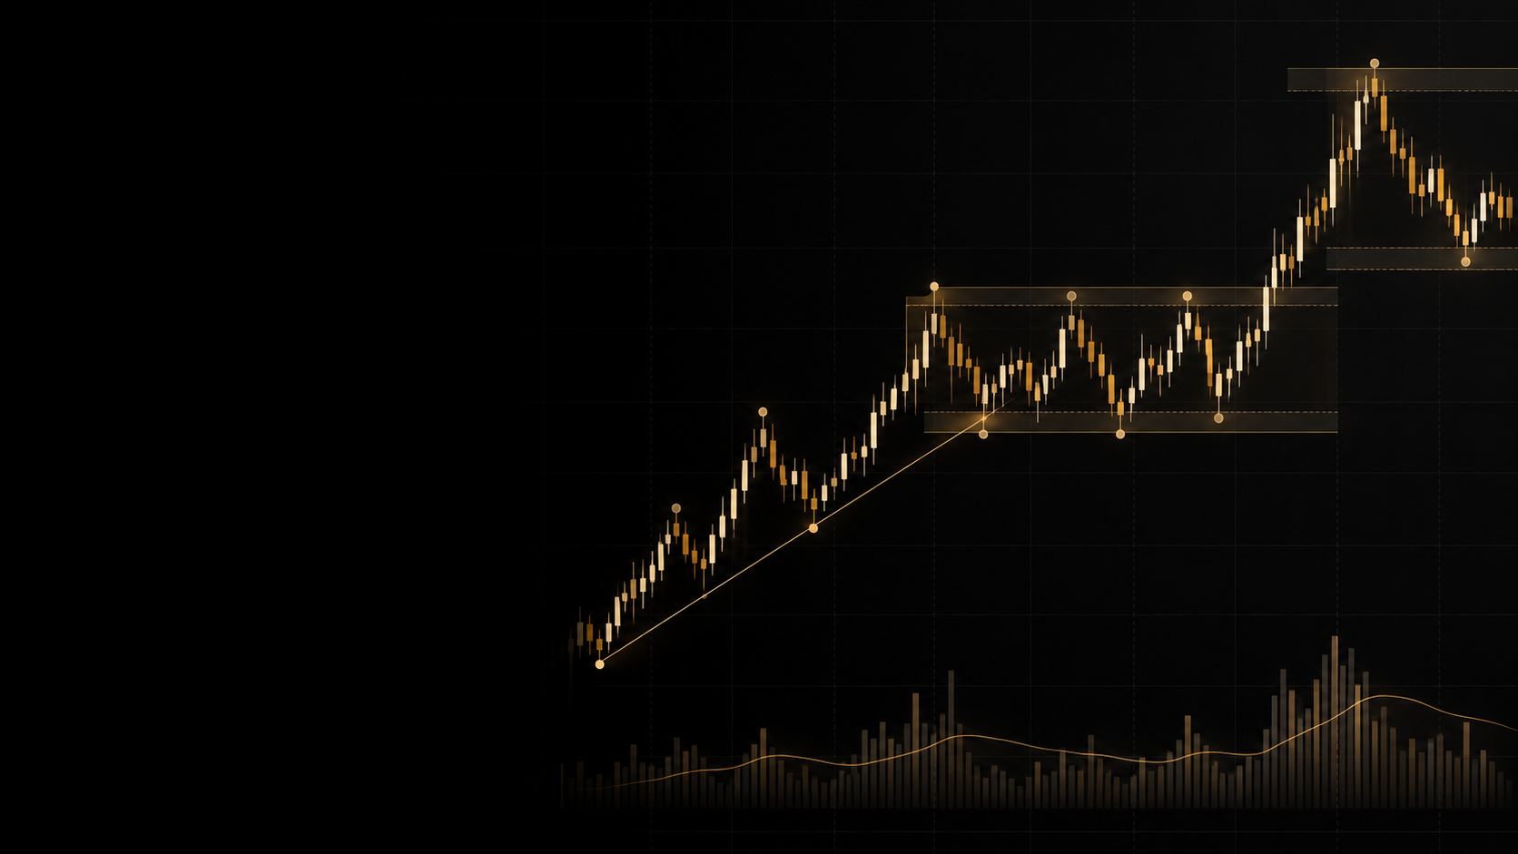
08 · CHART READING
A basic chart review
FOUR OBSERVATIONS
Each candle records the open, high, low and close
Swing highs and lows describe direction or rotation
Prior swing zones provide location context
Pattern names matter less without market context
Educational content only. General information, not personal advice. CFDs are leveraged and carry a high risk of loss. Consider the relevant PDS and TMD and whether the product is appropriate for you. TradingVibe Pty Ltd · ACN 686 041 903 · AFSL 569224
CFD & FOREX ESSENTIALS 09/12
Notes:
Source: TradingVibe Zero-Basis Public Course source deck, translated, restructured and updated for public education
Educational content only. General information, not personal advice. CFDs are leveraged and carry a high risk of loss. Consider the relevant PDS and TMD and whether the product is appropriate for you. TradingVibe Pty Ltd · ACN 686 041 903 · AFSL 569224

Slide 10
09 · COMMON ERRORS
Common beginner errors increase avoidable risk
BEFORE ENTRY
AFTER ENTRY
Using excessive size relative to the account
Entering without a defined invalidation point
Chasing price after a large move
Trading without checking costs or scheduled events
Moving the exit only to avoid accepting a loss
Adding exposure because a position moved against the plan
Taking repeated trades without a valid setup
Skipping the journal and repeating the same process error
Educational content only. General information, not personal advice. CFDs are leveraged and carry a high risk of loss. Consider the relevant PDS and TMD and whether the product is appropriate for you. TradingVibe Pty Ltd · ACN 686 041 903 · AFSL 569224
CFD & FOREX ESSENTIALS 10/12
Notes:
Source: TradingVibe Zero-Basis Public Course source deck, translated, restructured and updated for public education
Educational content only. General information, not personal advice. CFDs are leveraged and carry a high risk of loss. Consider the relevant PDS and TMD and whether the product is appropriate for you. TradingVibe Pty Ltd · ACN 686 041 903 · AFSL 569224

Slide 11
10 · CHECKLIST
A pre-trade decision sequence
01
02
03
04
Product
Context
Risk
Review
Understand contract size, costs, trading hours and margin terms.
Identify the market condition and any scheduled events that may affect volatility.
Set an invalidation level and calculate exposure before placing the order.
Record the rationale and assess the decision after the trade closes.
If any step is unclear, the trade can wait.
Educational content only. General information, not personal advice. CFDs are leveraged and carry a high risk of loss. Consider the relevant PDS and TMD and whether the product is appropriate for you. TradingVibe Pty Ltd · ACN 686 041 903 · AFSL 569224
CFD & FOREX ESSENTIALS 11/12
Notes:
Source: TradingVibe Zero-Basis Public Course source deck, translated, restructured and updated for public education
Educational content only. General information, not personal advice. CFDs are leveraged and carry a high risk of loss. Consider the relevant PDS and TMD and whether the product is appropriate for you. TradingVibe Pty Ltd · ACN 686 041 903 · AFSL 569224

Slide 12
tradingvibe.
COURSE COMPLETE
Clarity before execution
The next course develops platform skills, chart reading, a structured practice routine and trade review.
NEXT · INTERMEDIATE TRADING BOOTCAMP
Educational content only. General information, not personal advice. CFDs are leveraged and carry a high risk of loss. Consider the relevant PDS and TMD and whether the product is appropriate for you. TradingVibe Pty Ltd · ACN 686 041 903 · AFSL 569224
CFD & FOREX ESSENTIALS 12/12
Notes:
Source: TradingVibe Zero-Basis Public Course source deck, translated, restructured and updated for public education
Educational content only. General information, not personal advice. CFDs are leveraged and carry a high risk of loss. Consider the relevant PDS and TMD and whether the product is appropriate for you. TradingVibe Pty Ltd · ACN 686 041 903 · AFSL 569224

